Slide 1
KEONICS Computer Training Centre ( A Govt. of Karnataka Enterprise) IT Park – Hubballi

Slide 2
Candidates Details of KTC - Hubli for the year 2019-20
Sl No | Course Code | Course Name | No of Candidates Undergoing Training | No of Certificates Issued | Total no of Candidates
1 | ADCA | ADVANCE DIPLOMA IN COMPUTER APPLICATION | 60 | 3 | 63
2 | DCTTC | DIPLOMA IN COMPUTER TEACHERS TRAINING COURSE | 3 | 0 | 3
3 | DICA | DIPLOMA IN COMPUTER APPLICATION | 414 | 311 | 725
4 | DICFA | DIPLOMA IN COMPUTER FINANCIAL ACCOUNTING | 9 | 0 | 9
5 | OM | OFFICE MANAGEMENT | 62 | 48 | 110
6 | TALLY | TALLY ERP-9 LEVEL-1 | 94 | 130 | 224
7 | DTP | DTP-DESKTOP PUBLISHING | 14 | 5 | 19
8 | MSO | MS OFFICE | 22 | 27 | 49
9 | DLC | DIGITAL LITERACY COURSE | 36 | 17 | 53
10 | DIWD | DIPLOMA IN ADVANCED WEB DESIGNING | 45 | 19 | 64
11 | C Prog | BASIC PROGRAMMING USING C | 1 | 2 | 3
12 | C ++ | C++ PROGRAMMING ( PC++) | 1 | 8 | 9
13 | JAVA/J2EE | JAVA/J2EE | 0 | 2 | 2
14 | BWD | BASIC WEB DESIGNING | 9 | 1 | 10
15 | CLC | COMPUTER LITERACY COURSE | 4 | 42 | 46
16 | CHN | COMPUTER HARDWARE & NETWORKING | 1 | 0 | 1
17 | DEO | DATA ENTRY OPERATOR | 0 | 2 | 2
18 | DIAP | DIPLOMA IN ADVANCED PROGRAMMIING | 1 | 5 | 6
19 | Excise Dept. (Corporate Training) | OFFICE MANAGEMENT | 0 | 25 | 25
Total Candidates |  |  | 776 | 647 | 1423

Slide 3
Faculty Details
Sl. No | Name of Faculty | Gender | Job Role | Mobile No | Qualification | Experience in Keonics
1 | Mahantesh Bannimarad | Male | Faculty Head | 8095481266 | M.Sc-IT, PGDCA | 10 years
2 | Veena H. Alur | Female | Sr. Faculty | 9740095808 | B.Com | 14 Years
3 | Rashmi Vernekar | Female | Sr. Faculty | 8792919862 | M.Com, PGDCA | 12 Years
4 | Deepashri Teggihalli | Female | Sr. Faculty | 9844454884 | Diploma-CS, BCA, MCA | 6 Years
5 | Thulasi C. Alagawadi | Female | Jr. Faculty | 7411252957 | D.Ed, BA | 3 Years
6 | Sonali S. Raikar | Female | Jr. Faculty | 9902266947 | B.Com, M.Com | 2 Years
7 | Soumya S. Angadi | Female | Jr. Faculty | 9353966593 | BFT (Bachelor of Fashion Technolog) | 1 Year
8 | Soumya Gadagin | Female | Trainee Faculty | 8792298985 | B.Com | Fresher
9 | Vijay Tallolli | Male | Guest Faculty | 9731251461 | M.Sc, CS | 3 Years
10 | Vijay Pattar | Male | Guest Faculty | 9886606830 | M.Sc,CS | 3 Years

Slide 4
INFRASTRUCTURE
Training Centre Space – 2600 Square feet.
Number of Computers – 56.
5 KVA – UPS – 2 Nos.
Printers – 3 Nos.
Adhar Enabled Bio Metric Machine – 1 Nos.
40” Smart TVs (Used for Demo Purpose) – 3 Nos.
FTTH – Broadband Internet Facility.
CCTV Cameras – 5 Nos.
Demo Theory Classes – 3 Nos.
Computer Lab – 3 Nos.

Slide 5
KEONICS TRAINING CENTRE- HUBLI
Income & Expenditure for the year 2019-20
A Income |  | B Expenditure
Month | Paid candidates fees Collection in ` | KEONICS staff Salary in ` | Petty Cash, Wi Fi Telephone and other claiming Expenses in ` | Office Assistant salary Bill in ` | Faculty Charges in ` | Total expenses in ` | Profit = A-B in `
Apr-19 | 313970 | 90003 | 8104 | 6500 | 116533 | 221140 | 92830
May-19 | 315983 | 95265 | 7999 | 6500 | 100682 | 210446 | 105537
Jun-19 | 472093 | 95295 | 9684 | 6500 | 108495 | 219974 | 252119
Jul-19 | 665335 | 90003 | 7998 | 6500 | 130982 | 235483 | 429852
Aug-19 | 383550 | 92493 | 7419 | 6500 | 134891 | 241303 | 142247
Sep-19 | 477242 | 92493 | 7649 | 6500 | 111742 | 218384 | 258858
Oct-19 | 327996 | 92493 | 8000 | 6500 | 119533 | 226526 | 101470
Nov-19 | 376354 | 92493 | 8012 | 6500 | 114680 | 215112 | 161242
Dec-19 | 983141 | 82044 | 5165 | 3250 | 119180 | 209639 | 743206
Jan-20 | 1044865 | 82044 | 7981 | 0 | 0 | 90025 | 954840
Feb-20 | 324903 | 82044 | 7713 | 0 | 0 | 89757 | 235146
Mar-20 | 237200 | 83244 | 6581 | 0 | 125330 | 215155 | 22045
 | 5922632 | 1069914 | 92305 | 55250 | 1182048 | 2392944 | 3499392
 |  |  |  |  |  | Asst.Manager-Tech KTC-Hubli

Slide 6
KEONICS TRAINING CENTRE- HUBLI
Income & Expenditure for the year 2018-19
A Income |  | B Expenditure
Month | Paid candidates fees in ` | KEONICS staff Salary in ` | Petty Cash, Telephone and other claiming Expenses in ` | Office Assistant salary Bill in ` | Faculty Charges in ` | Total expenses in ` | Profit = A-B in `
Apr | 288461 | 87600 | 11904 | 6500 | 104557 | 210561 | 77900
May | 417486 | 88100 | 15730 | 6500 | 111057 | 221387 | 196099
June | 382176 | 89346 | 15457 | 6500 | 113107 | 224410 | 157766
July | 514316 | 96997 | 9761 | 6500 | 130173 | 243431 | 270885
Aug | 513887 | 92162 | 9618 | 6500 | 148765 | 158383 | 355504
Sep | 471344 | 91542 | 10993 | 6500 | 155404 | 264439 | 206905
Oct | 323317 | 92999 | 12301 | 6500 | 146235 | 258035 | 65282
Nov | 228860 | 96827 | 11284 | 6500 | 121505 | 236116 | -7256
Dec | 676144 | 67999 | 10075 | 6500 | 110759 | 195333 | 480811
Jan | 548328 | 64670 | 11500 | 6500 | 132435 | 215105 | 333223
Feb | 483018 | 60235 | 10500 | 6500 | 155237 | 232472 | 250546
Mar | 474252 | 71999 | 7881 | 6500 | 122918 | 209298 | 264954
 | 5321589 | 1000476 | 137004 | 78000 | 1552152 | 2668970 | 2652619
 |  |  |  |  |  | Asst.Manager-Tech KTC-Hubli

Slide 7
Marketing Details
Insertion of Pamphlets in news papers every month
Distribution of Pamphlets at exam centres on last day of SSLC & PUC Exams
Occasionally Conducted Seminars in some colleges
Visited near by villages and pasted wall posters
2 days free work shop regarding importance of computer learning.

Slide 8
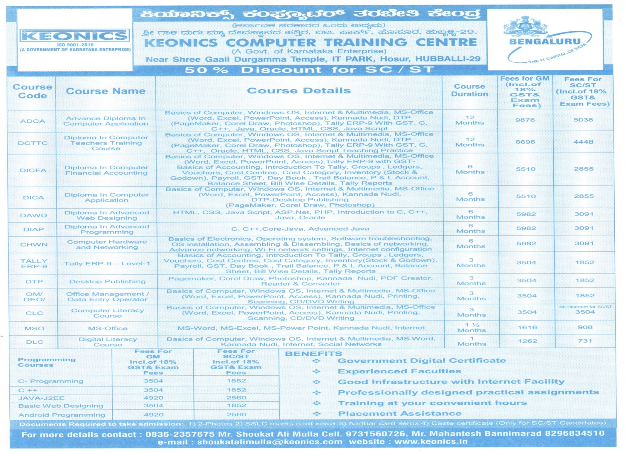
Pamphlet Containing Course Details

Slide 9
Thank You

